Slide 1

Media campaign cost Prediction
Group 2:
Ashishkumar Trada (N01580242)
Dhruv Patel (N01578896)
Yug Sutariya (N01580206)

Slide 2
Agenda
Introduction
Methodology
EDA
Model and result
Summary
Presentation Title

Slide 3

Introduction
The project aims to optimize marketing costs for Food Mart, a leading convenience store chain, using machine learning techniques. It analyzes customer data to predict campaign costs, employing models like linear regression and decision trees. The goal is to inform marketing decisions and maximize ROI for Food Mart and similar businesses.

Slide 4


Methodology
Media
cost

Slide 5
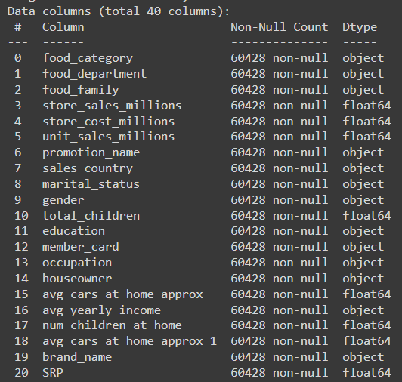
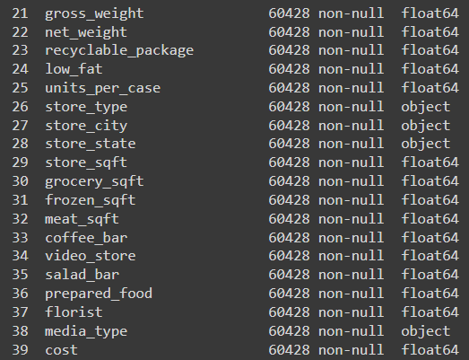
Dataset Description
https://www.kaggle.com/datasets/ramjasmaurya/medias-cost-prediction-in-foodmart

Slide 6
Exploratory Data Analysis (EDA)

Slide 7
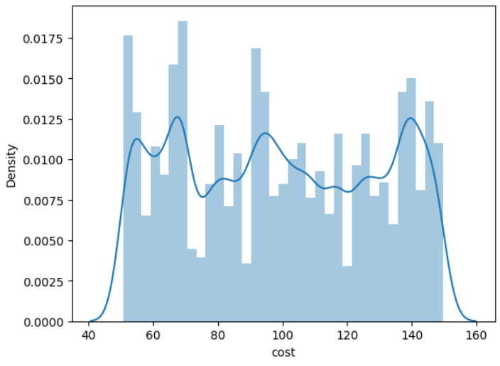
Target Distribution
We can see that the distribution of our Cost feature (our target value) is not normally distributed but is not skewed either.

Slide 8
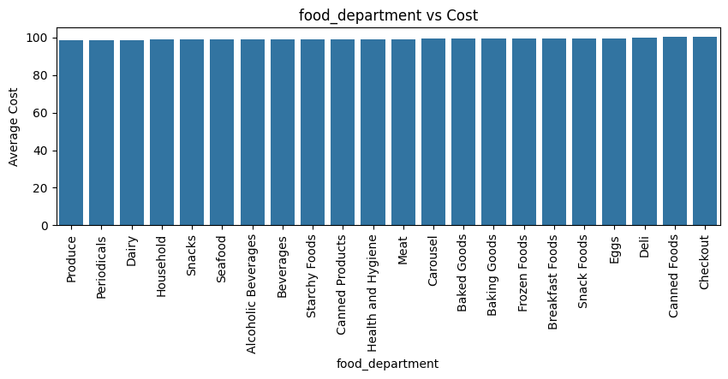
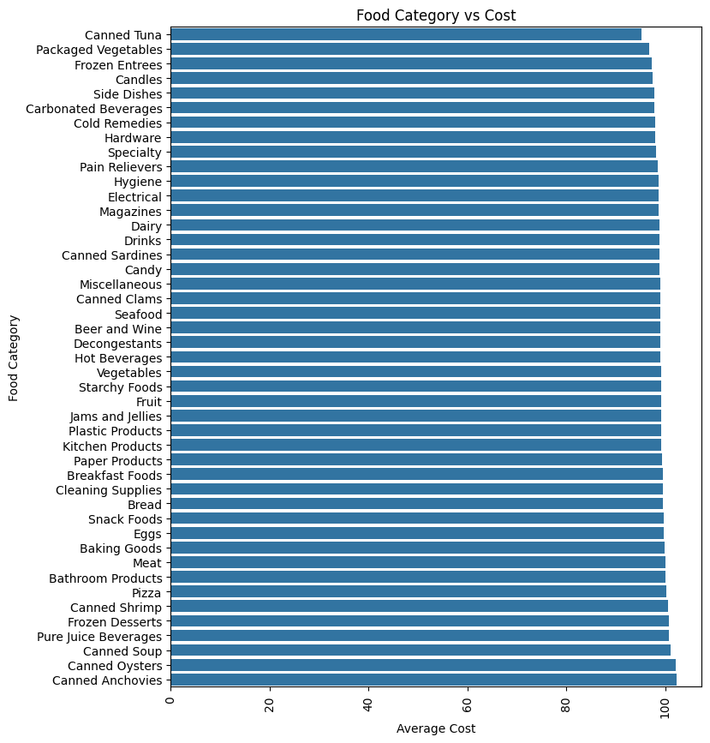
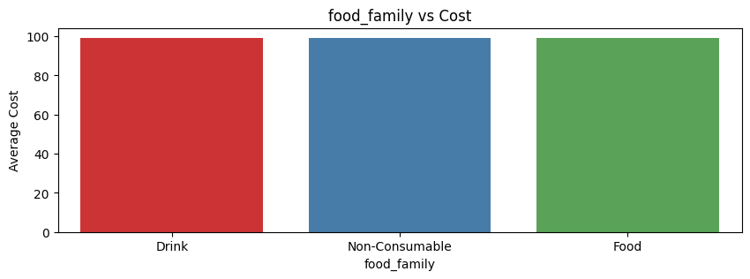
Food Feature

Slide 9
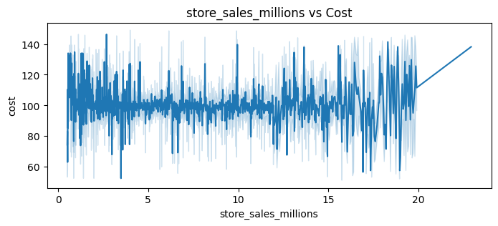
Store sales
It seem from the data that cost doesn’t affect the store sales

Slide 10
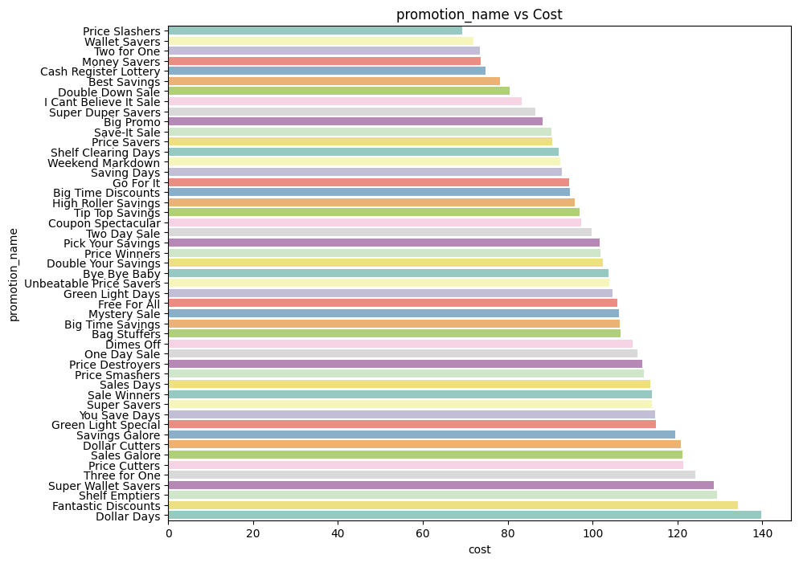
promotion name on cost
The bar chart reveals significant variations in average cost across different promotion names.
The average cost of promotions varies significantly depending on the promotion name.
means positive relationship

Slide 11
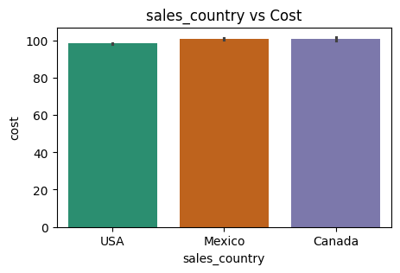
Store country
Store media cost does not affect by
the store location

Slide 12
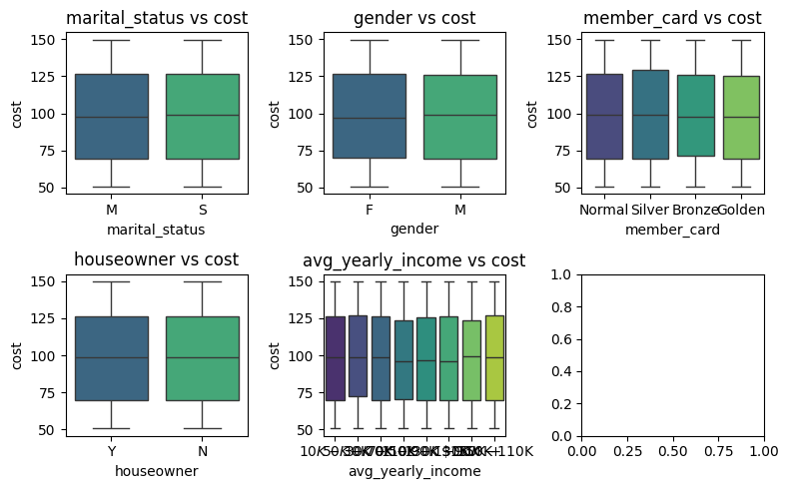
Customer features
Customer data does not affect the cost of media

Slide 13
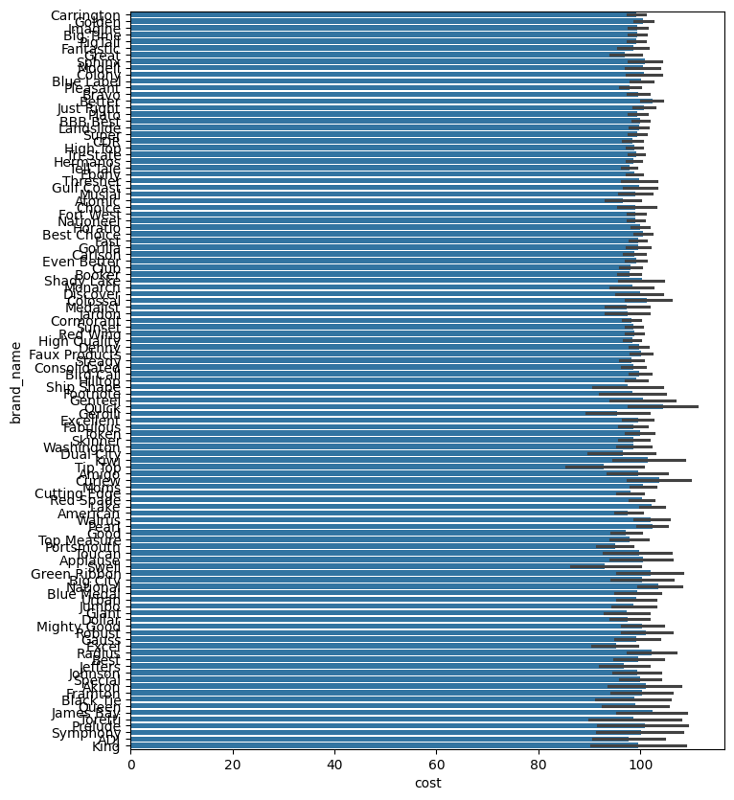
Impact of product brand name on cost

Slide 14
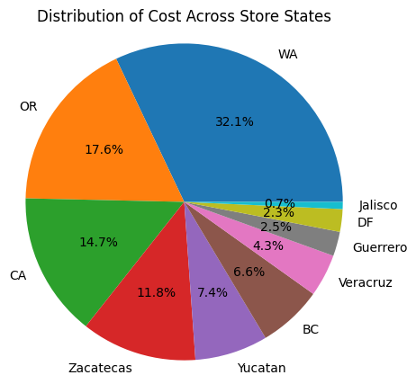
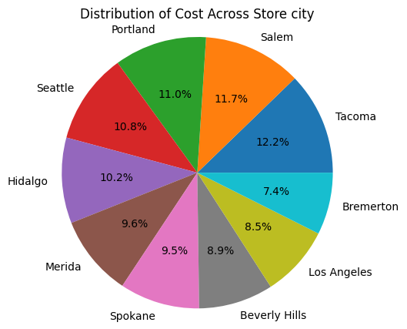
Distribution of cost across state and city

Slide 15
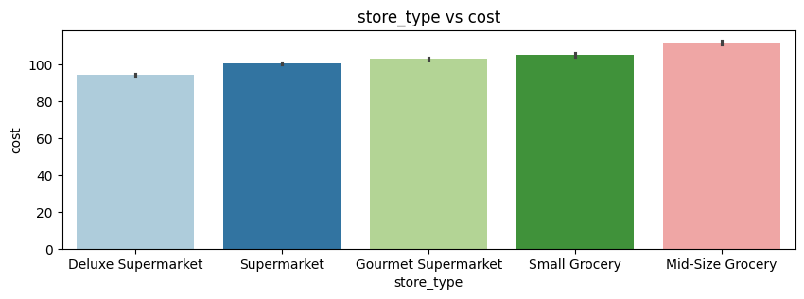
Impact of store type on cost

Slide 16
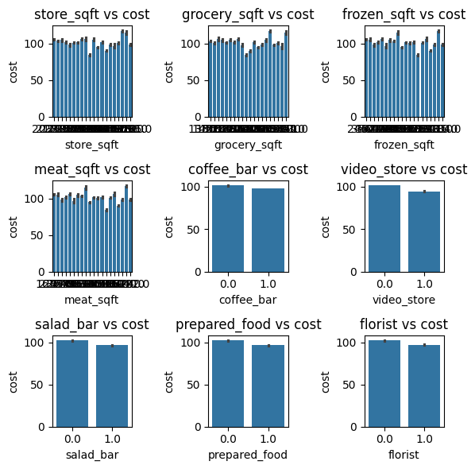
Store characteristics on cost

Slide 17
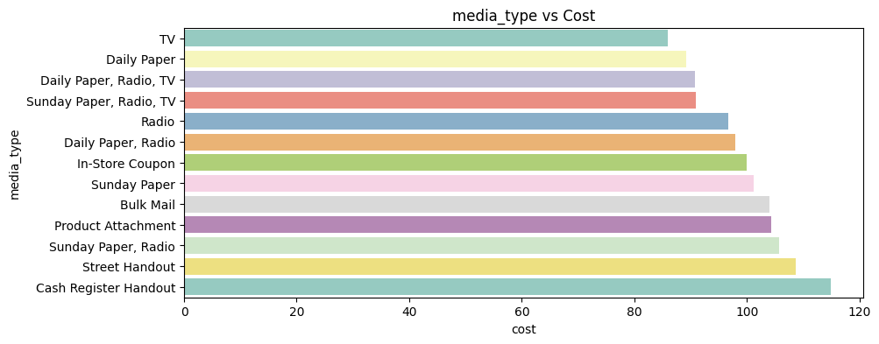
Media type on cost
Significant difference

Slide 18
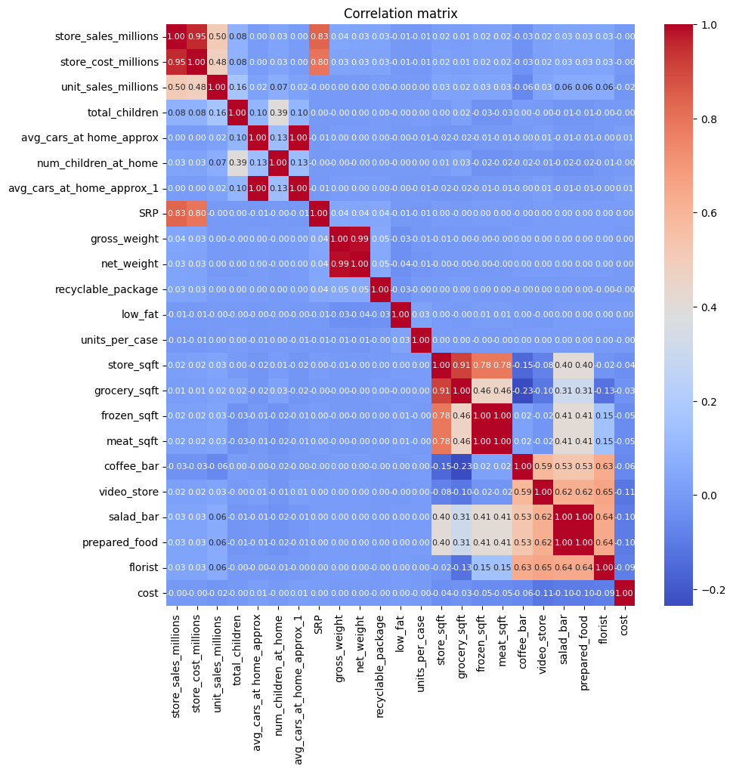
Correlation Matrix

Slide 19
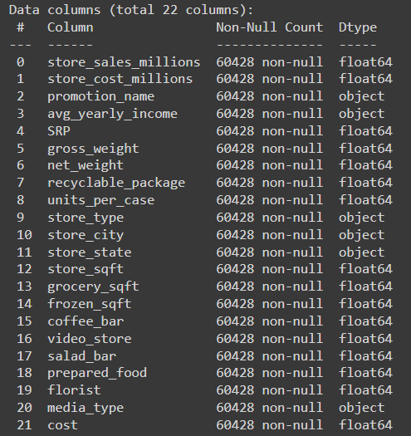
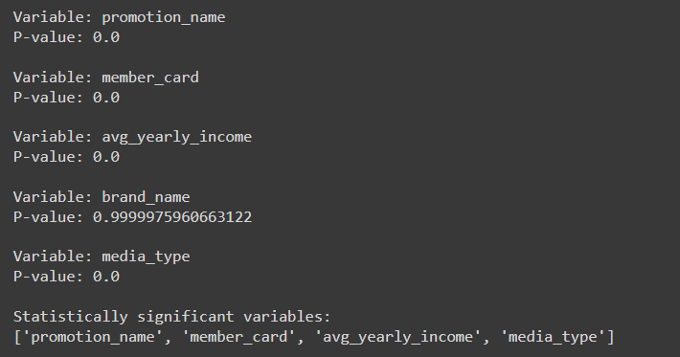
Feature Selection
Chi2 method on categorical data
EDA and correlation for numeric data

Slide 20
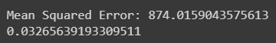
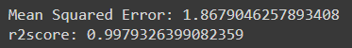
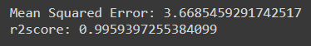
ML Model and Result
Regression
RandomForestRegressor
DecisionTreeRegressor

Slide 21
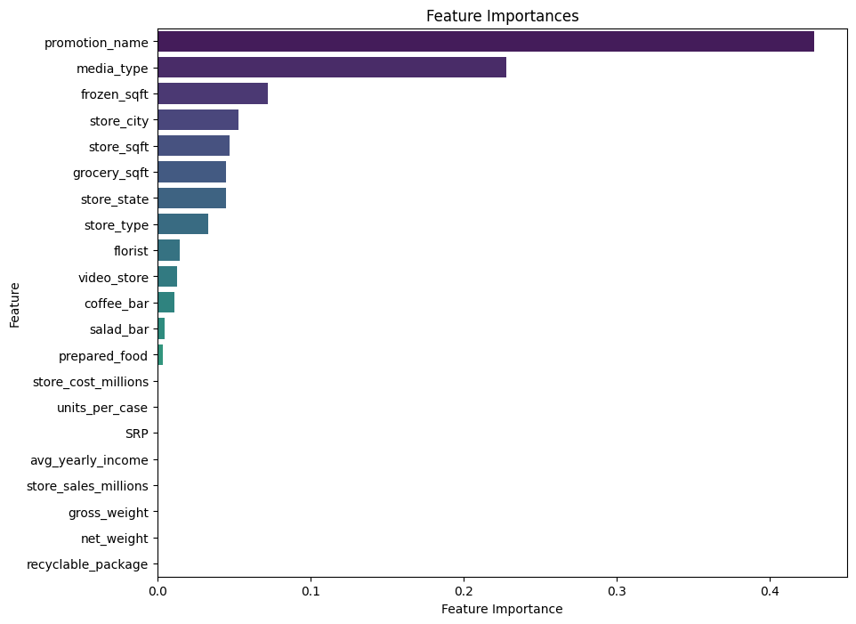
Feature Importance
Based on RandomForest

Slide 22

Influential Parameters:
Promotional activities
store characteristics such as type, location, and physical attributes
Optimizing promotions and store infrastructure could effectively control campaign expenses and maximize results.

Slide 23
Model Result on Brief
Regression:
Poor performance, indicating linear assumptions are inadequate.
DecisionTree:
Improved performance but might suffer from overfitting.
RandomForest:
Best performance, suggesting its effectiveness in handling complex data and providing accurate predictions.

Slide 24


Summary
Using machine learning, we accurately forecasted media campaign costs for Food Mart stores by analyzing customer demographics, product data, promotions, and store features. The random forest model proved most effective, emphasizing the significance of promotions and store attributes in cost prediction. By optimizing these factors, businesses can elevate marketing strategies and boost returns on investment, illustrating the impact of data-driven decision-making in retail.

Slide 25




Thank you

